Slide 1
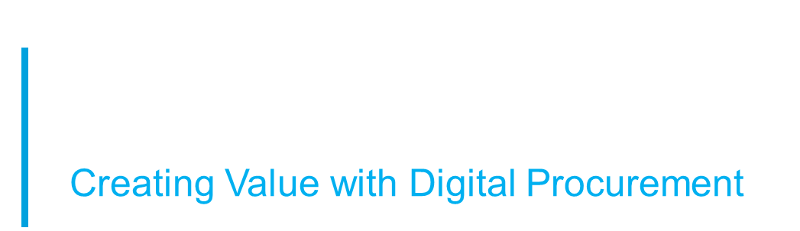






Contract Lifecycle Management live for all of Procurement
Icertis for Suppliers – User Support Document
S2C Platform
Infineum is changing the way we do Contract Lifecycle Management. ICI is the tool that will be used to automate contract process, approvals, and centralise contract data and analytics.
Suppliers will receive communications from ICI for contract negotiation, renewal, and other amendments.
Buyers
and Legal
Strategic Sourcing
Contract Lifecycle Management
What is expected from suppliers?
To keep an eye out for email notifications from Icertis ICI Contract Management containing the link to the agreement
To make changes to the agreement if needed and submit to Infineum for review or sign the agreement and submit
What can you find in this document?
Tips on how to review the contract
Tips on how to sign the contract

Slide 2
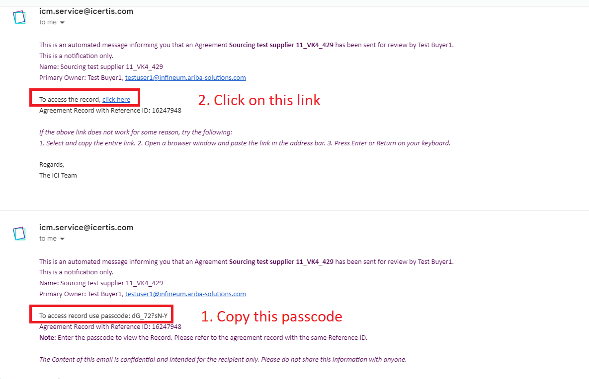

How to review the contract
You will receive an email notification from ICI with a link to review the agreement
Click on the link to access digital contract
The link in the email will not expire when there are open actions available.
Once you have taken action the link will be disabled
All changes will be reflected in ICI with a full history of amends visible
If the link does not work for any reason, please contact your Infineum Buyer who will resend the link.

Slide 3
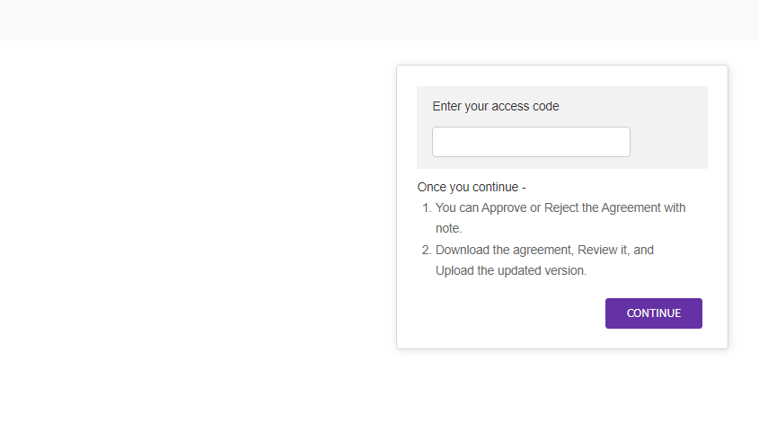
How to review the contract
You will receive a second email from ICI containing the passcode to enable you to view the agreement provided in the link.
A new window will open, asking you for the passcode. Enter the passcode by copying it from the email.
Use passcode to view agreement provided in the link
Use passcode received in the email

Slide 4
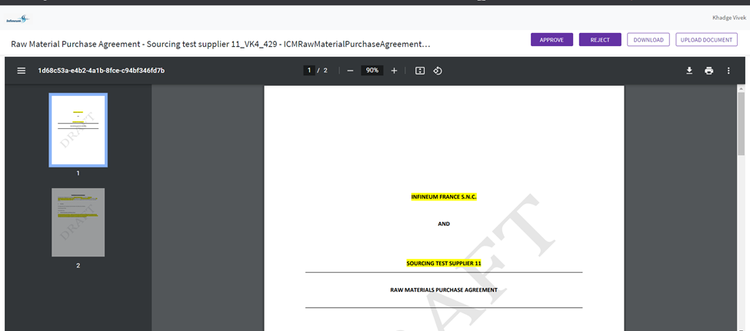
How to review the contract
You can download the agreement, make required changes and then upload the agreement and approve/reject with notes.
1. Download the agreement using the ‘Download’ button and make the required changes in the document.
3. ‘Approve’ or ‘Reject’ the agreement. You will have an option to leave notes for the buyer.
2. Upload the agreement using ‘Upload Document’ button.
NOTE:
The ‘Approve’ or ‘Reject’ button is not for signature, but for review only. The signature process is a separate email notification from DocuSign.

Slide 5
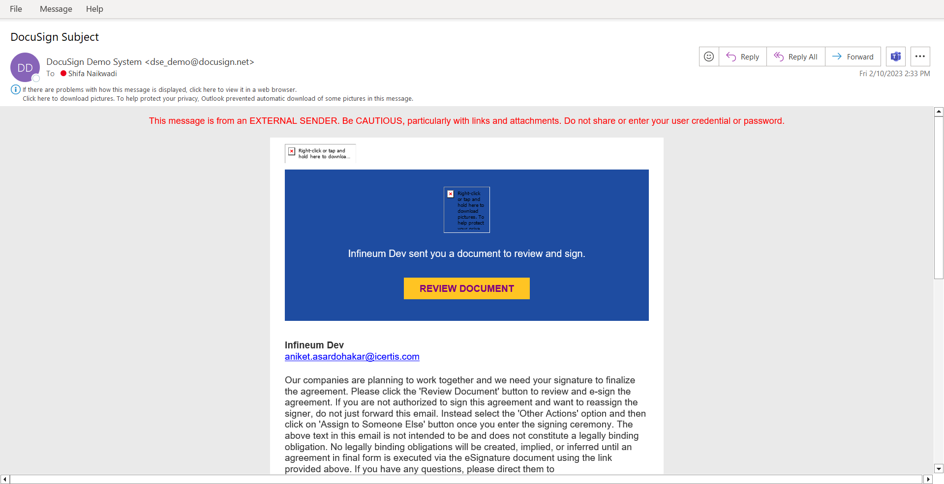
How to sign the contract
You will receive agreement from DocuSign via email
Click on ‘Review Document’ button to view the agreement

Slide 6
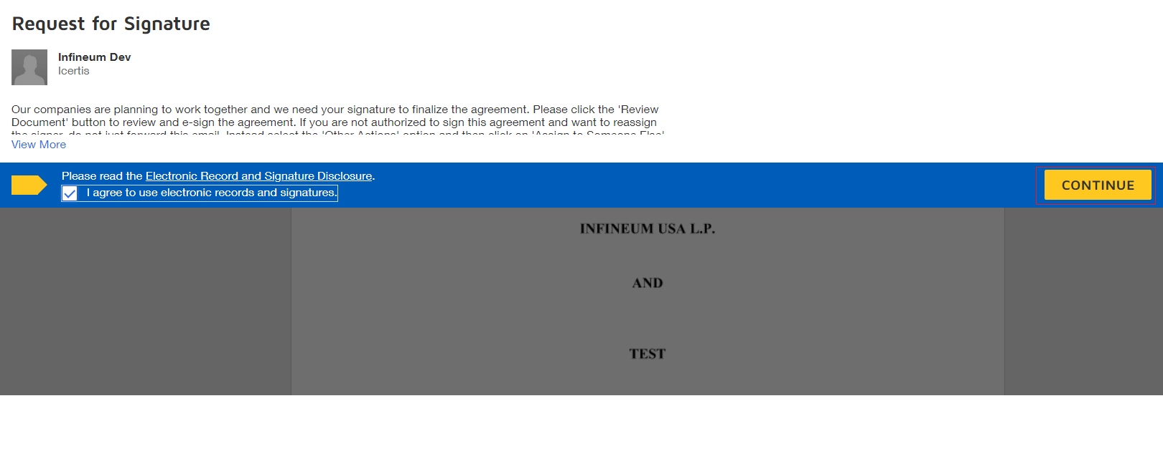
How to sign the contract
Email from DocuSign
Click on ‘Continue’ button to sign the agreement amendment
For electronically signing the document click on ‘I agree to use electronic records and signatures’

Slide 7
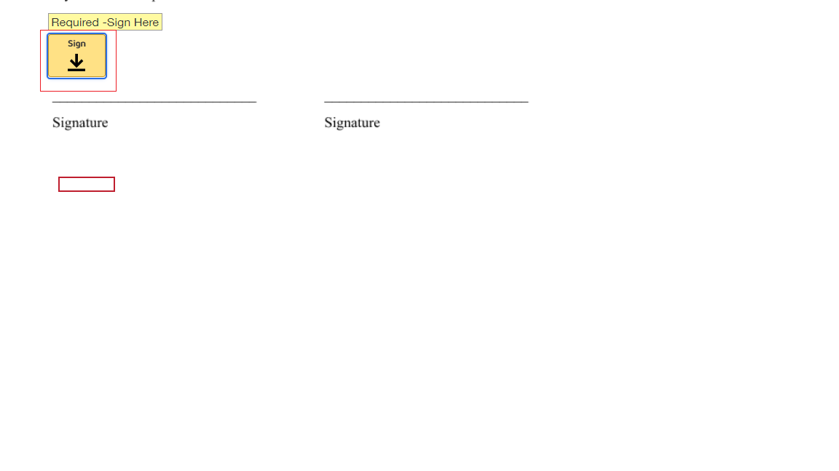
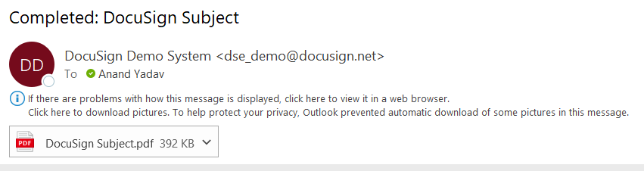
How to sign the contract
Sign the agreement
You will receive signed PDF file of agreement via mail

