Slide 1






Digital Sourcing live for all of Procurement
SAP Ariba for Suppliers – User Support Document
S2C Platform
Infineum’s S2C Platform will use SAP Ariba for E-Sourcing
Simfoni will be used instead of SAP Ariba for Logistics Sourcing
This platform will be integrated with Infineum’s existing tools
Infineum Buyer
Strategic Sourcing
Contract lifecycle mgmt.
Suppliers
What we expect from our suppliers
To move away from responding to bids through email, texts, and Excel
Start responding to bids on SAP Ariba Network
What will you find in this document?
Tips on how to use Ariba Commerce Cloud
Tips on how to find help

Slide 2
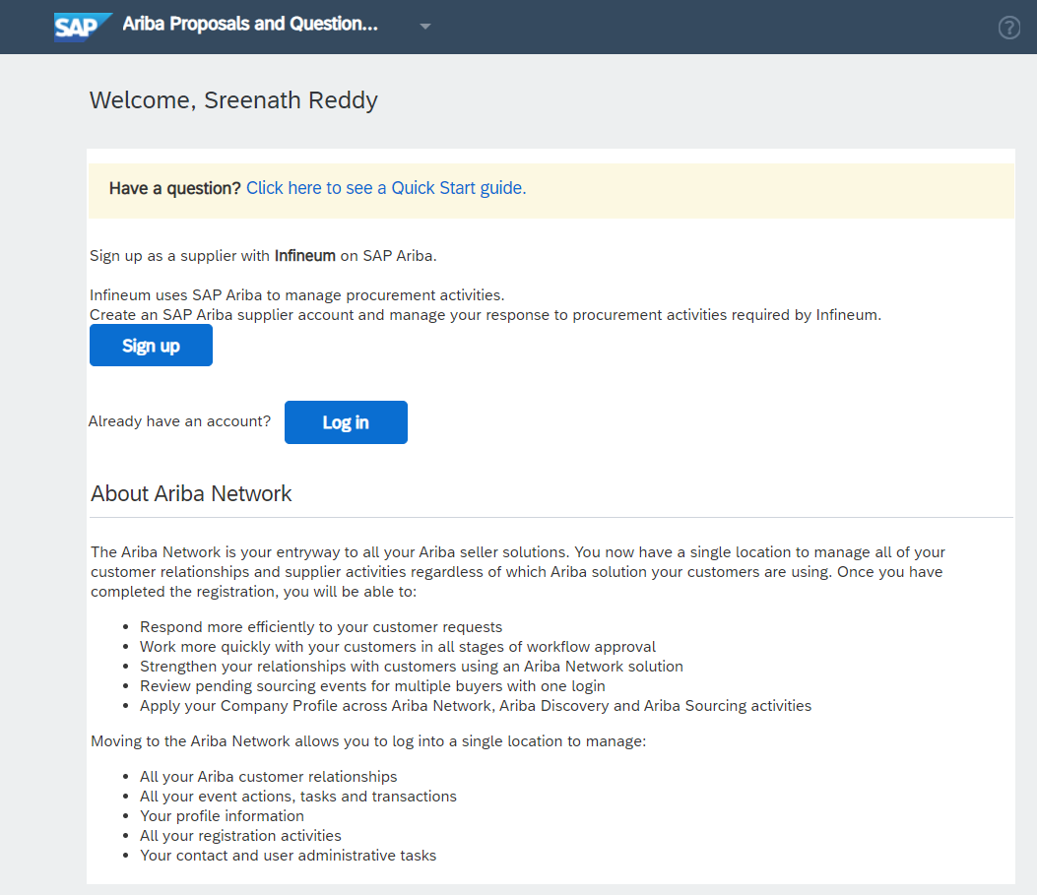
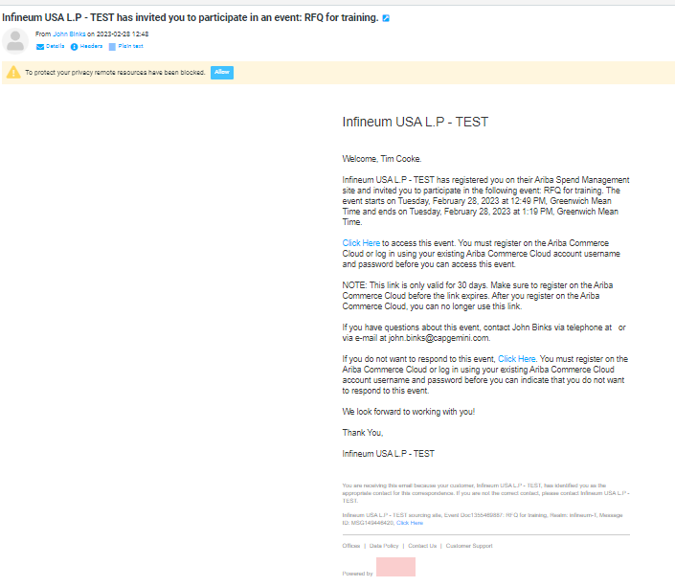
How to login
You will receive an email from Infineum with a link to participate in a sourcing Event
When clicking to access the Event, the system will direct you to the Supplier Sign-up page
To respond in SAP Ariba, ‘Click Here’
Click here to sign up
Click here if you already have SAP Ariba account
Access link is valid for 30 days.
This is not the deadline to submit your response
Notes:
Need screenshot with create account

Slide 3
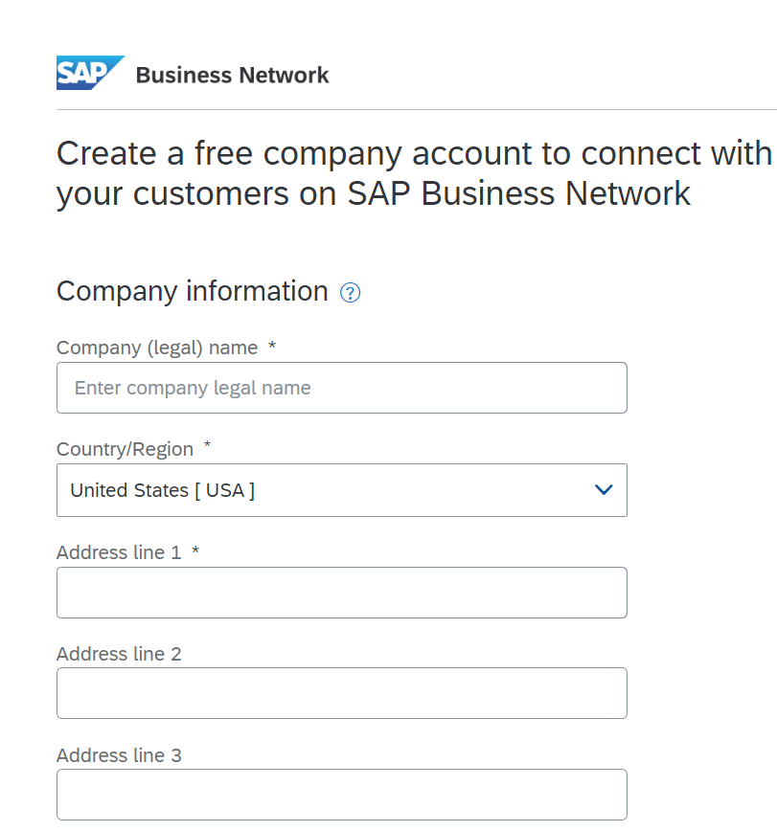
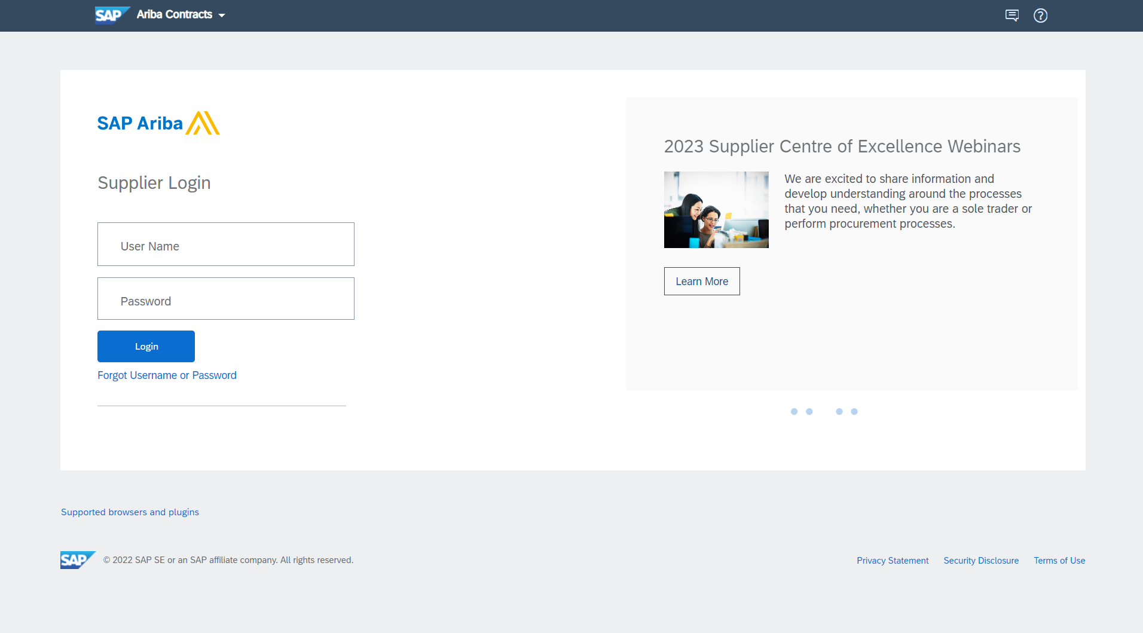
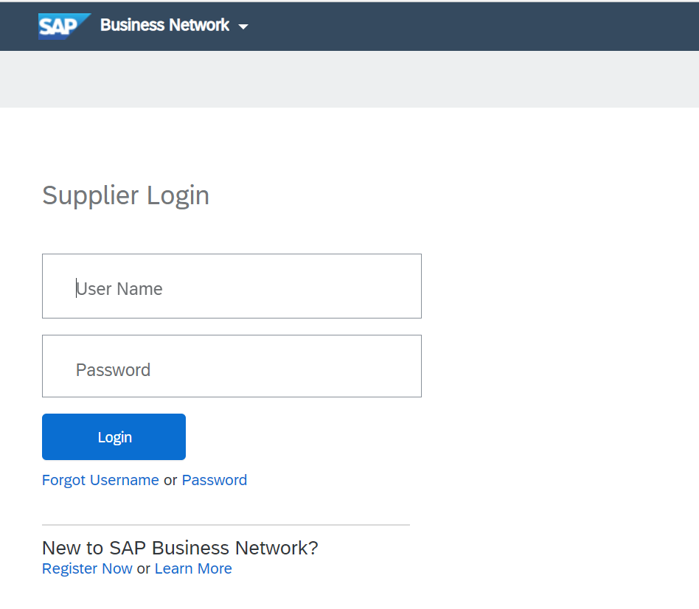

Creating an account in SAP Ariba
Having an issue logging-in? Click on the question mark to open the
Help Center
Creating a new SAP Ariba account
Already have an account?
Creating an account is free
Enter your existing user ID and password
Enter your company information and setup the user ID and password for yourself
Click here if you have forgotten credentials
If your company has more that one office, please enter the main office address. You can enter your shipping, billing or other addresses later in your company profile
Notes:
Can vendor have multiple account, nothing is centralized? Can any account manager create a new SAP Ariba profile? Is this an issue?
Add note – check within your organizatin, if there is already a centralized account you can be added to.

Slide 4
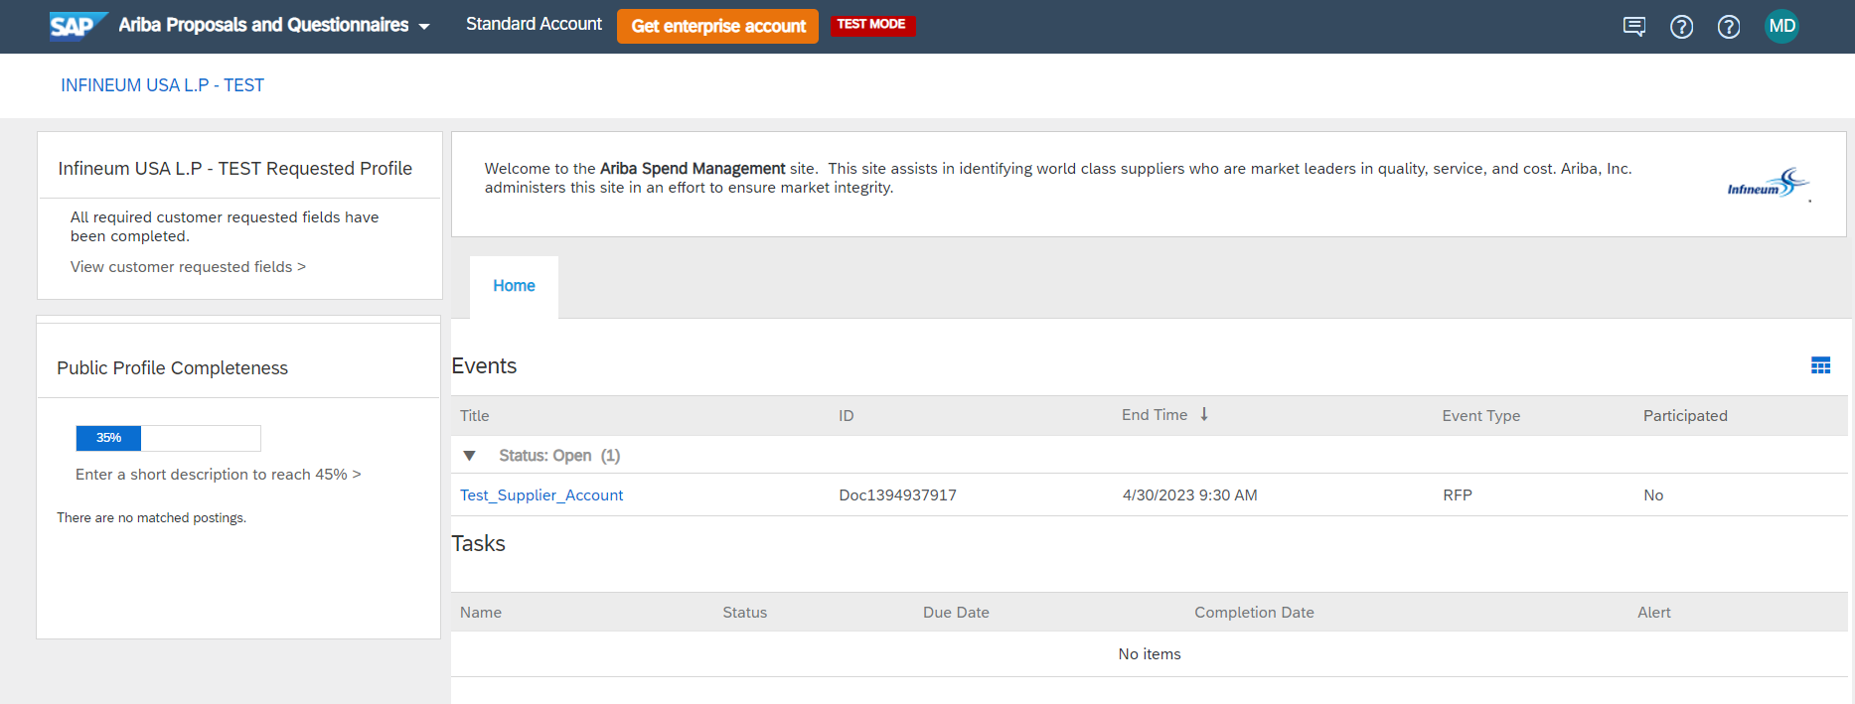
How to open the Event
You need to be on the Ariba Proposals and Questionnaires screen to access the sourcing Event
Access the Open Event you have received from Infineum
Time remaining to respond will update in real-time
Event type will be listed
Click on the Event title to open it

Slide 5
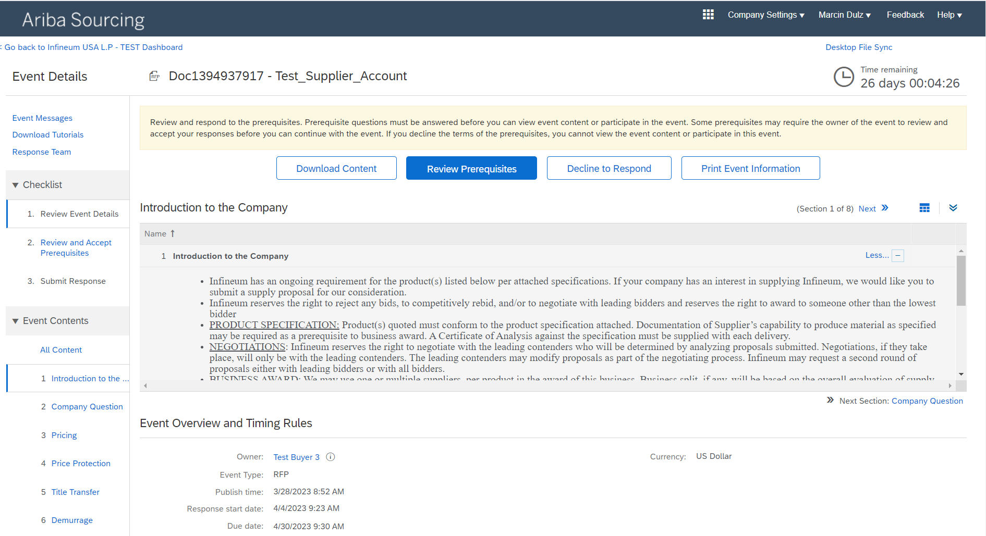
How to respond to the bid
Time remaining to respond will update in real-time
Click ‘Review Prerequisites’ to view Event content

Slide 6
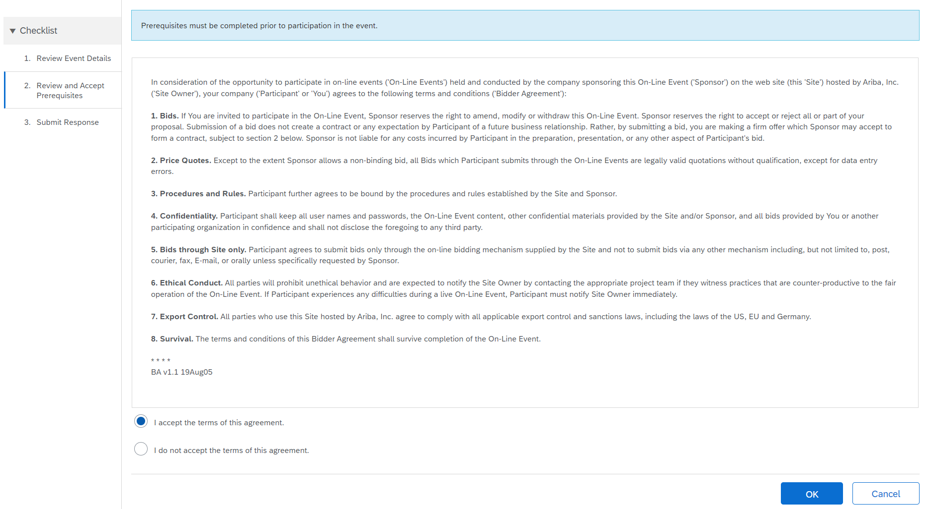
Review and Accept Prerequisite
Prerequisites need to be accepted prior to participating in the Event
Review terms of the agreement and select ‘I accept’
Click ‘OK’ to confirm

Slide 7
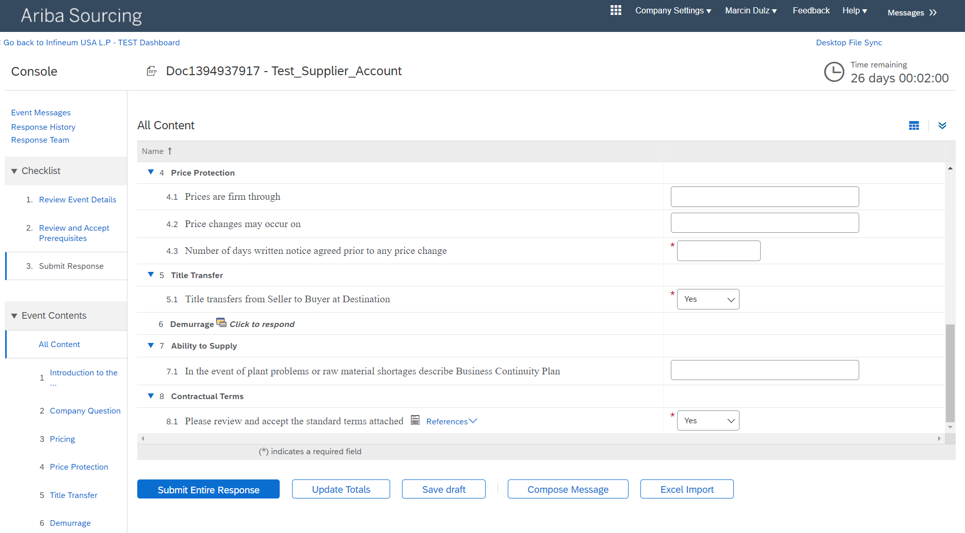
How to respond to the bid
Check if you have received any messages from the Buyer
Time remaining to respond will update in real-time
Under ‘Checklist’ you will find the tasks to complete in order to submit the response
Provide a detailed response, and complete all mandatory fields
Click ‘Submit Entire Response’
After responding you will have an option to ‘Revise Response’ and ‘Compose Message’ to Buyer

Slide 8
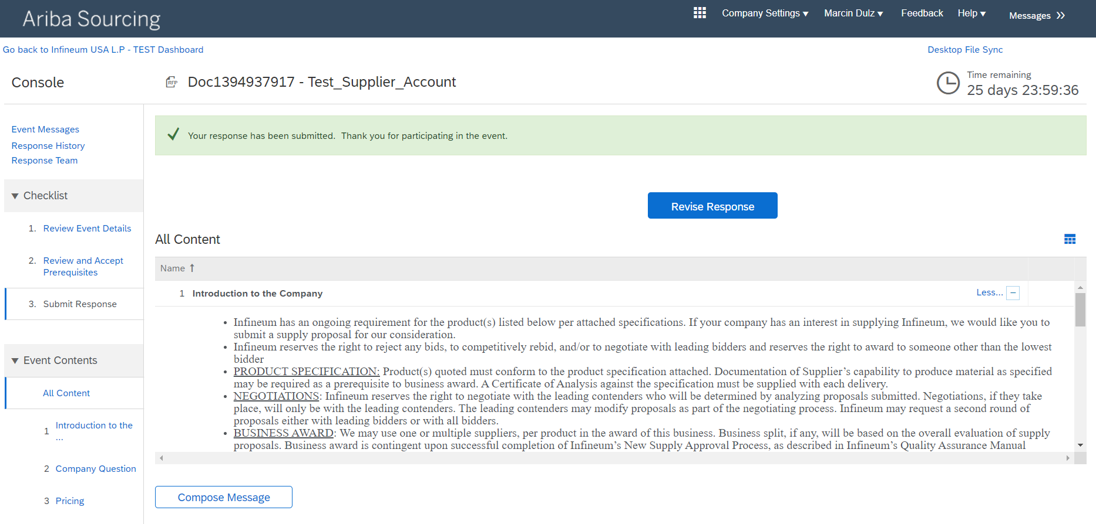
How to respond to the bid
You will receive confirmation that your response has been submitted
You can still review and edit your response if the Event is still open
Click ‘Compose Message’ if you would like to send a message to the Buyer through SAP Ariba

Slide 9
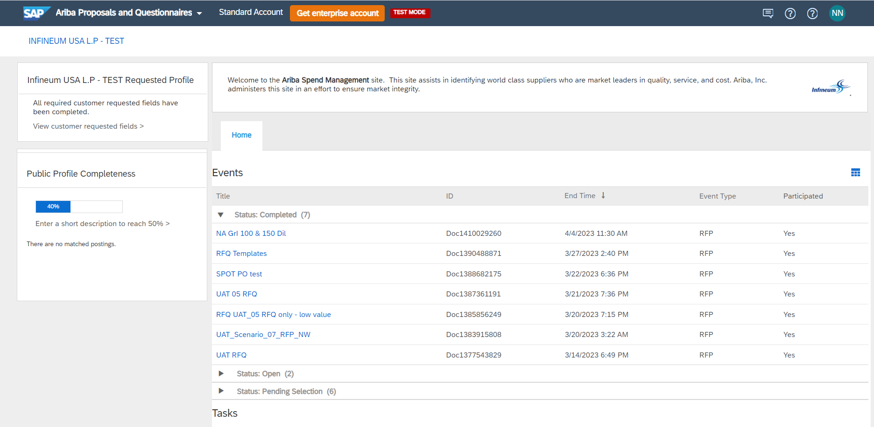
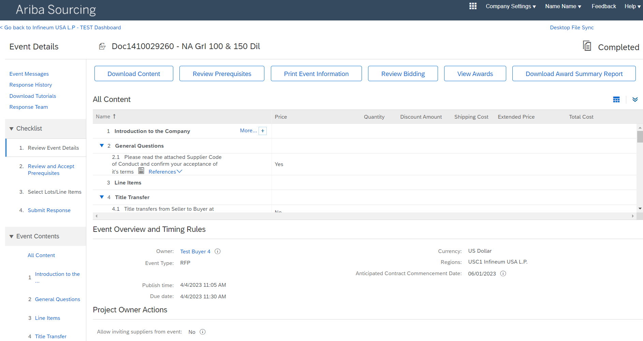
How to view different status of the Event
You need to be on the Ariba Proposals and Questionnaire screen to access the sourcing Events
Click on ‘Completed Event’ to check the status of your bid

Slide 10
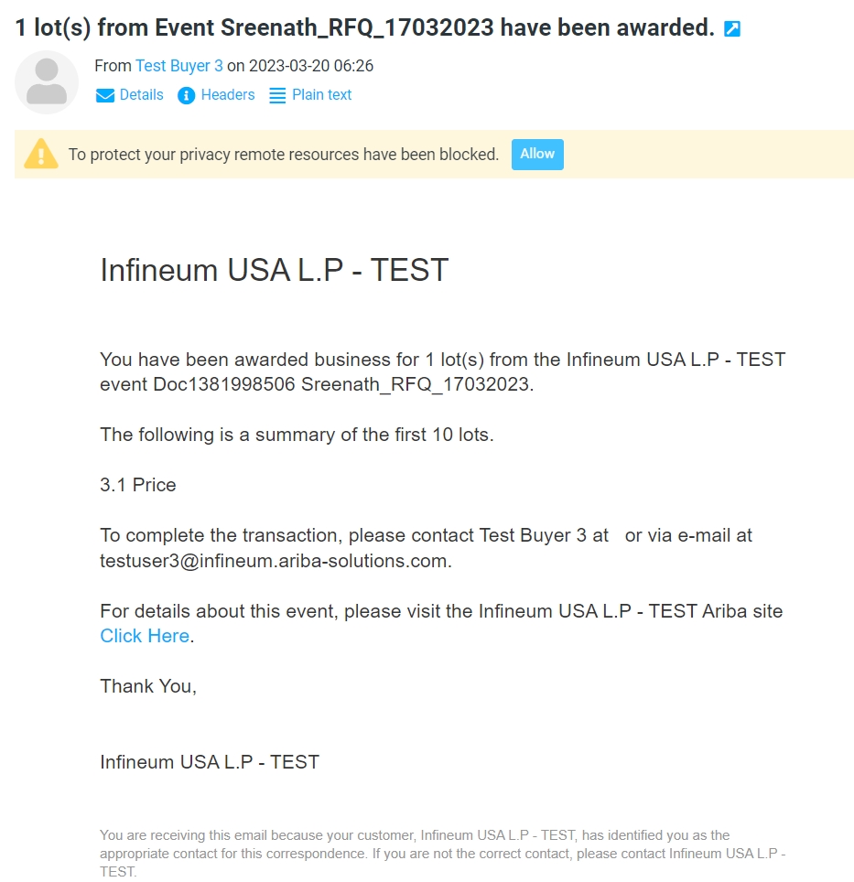
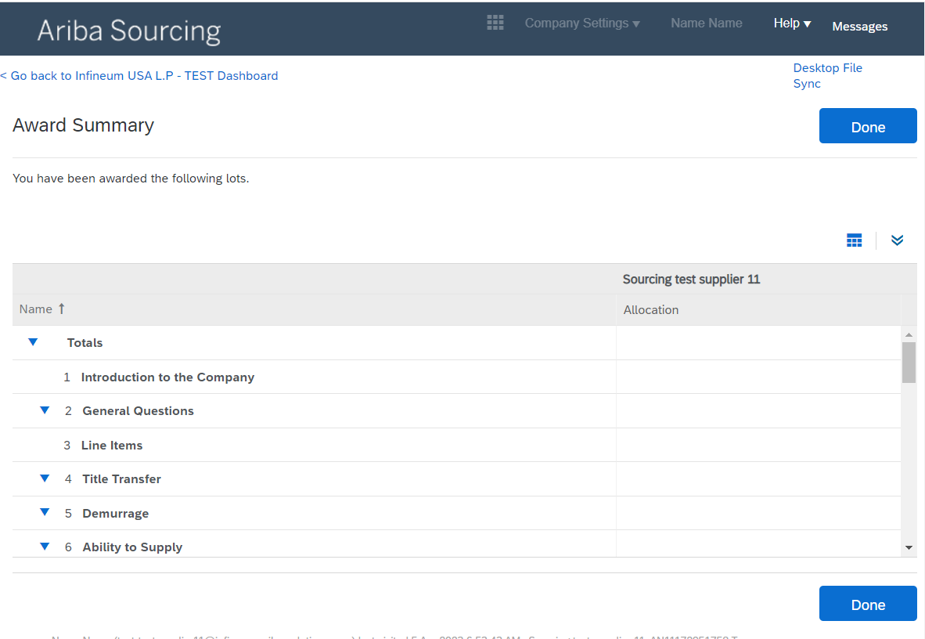
How to find out if you won the bid
You will receive an email from Infineum confirming you have been awarded the bid
For more details about this Event, ‘Click Here’

Slide 11
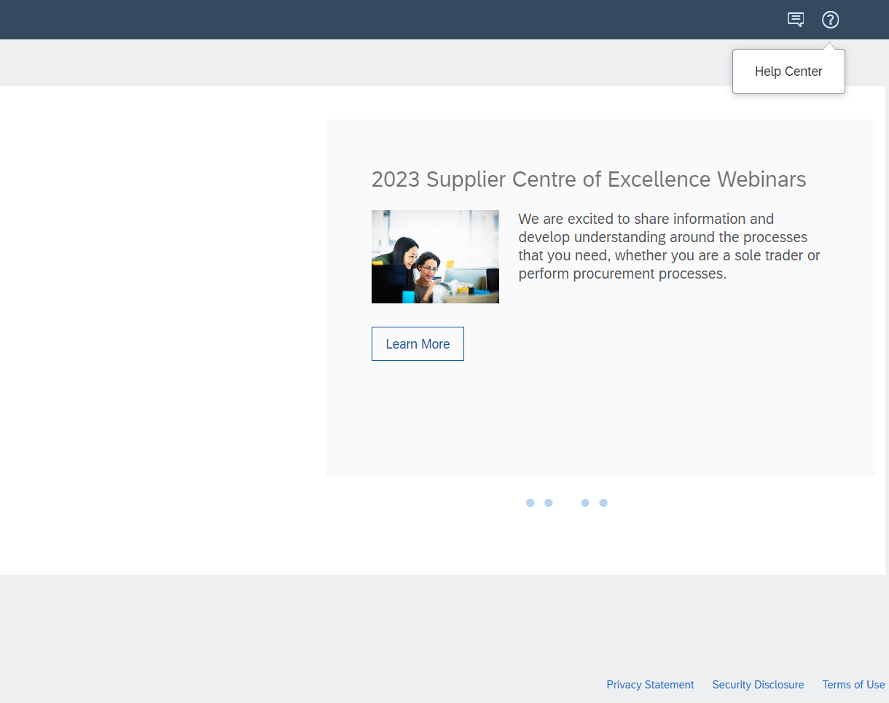
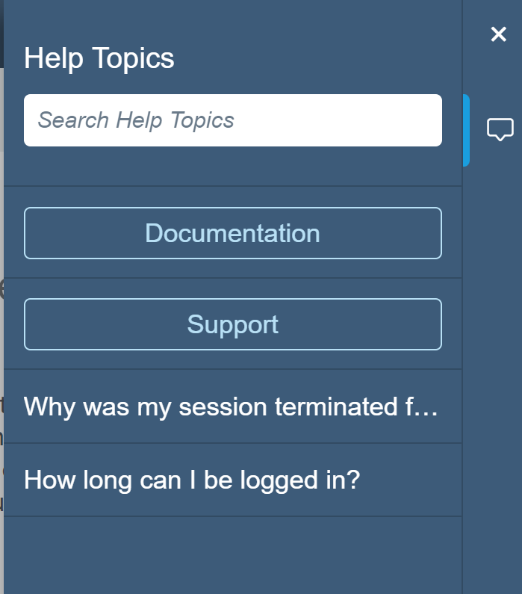
Where to find help
Go to the top right corner and click on the question mark
Click on Help Centre and search ‘Help Topics’
Examples of support materials available in search
Supplier account login
Forgot username
Forgot password
Proposals
Event participation
Sourcing event
View award
Account
Warning messages
Error messages

Slide 12
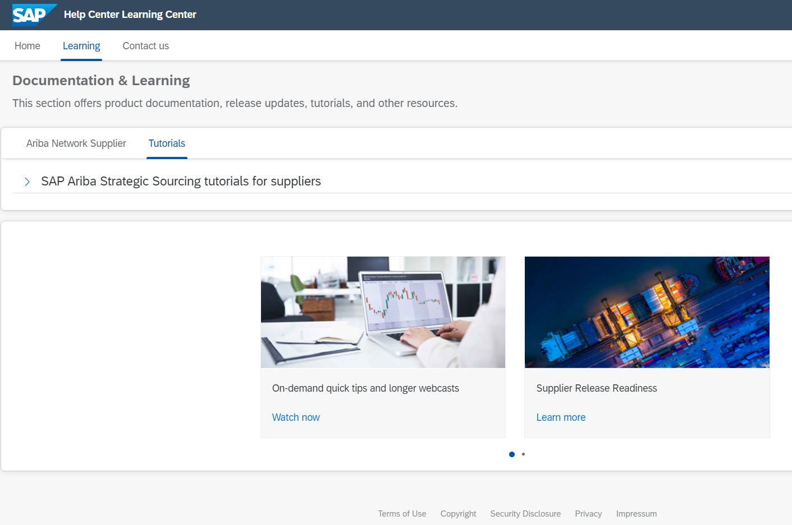
How to find training videos or further support
Go to ‘Learning’ section
If you need any help from Ariba support, click on ‘Contact us’
Click to access short, self-help training videos

