Slide 1






Digital Sourcing live for all of Procurement
Simfoni for Logistics Suppliers – User Support Document
S2C Platform
Infineum Buyer
Strategic Sourcing
Contract lifecycle mgmt.
Suppliers
What we expect from our suppliers
To move away from responding to bids through email, texts, and Excel
Start responding to bids on Simfoni
What will you find in this document?
Tips on how to respond to bids in Simfoni

Slide 2
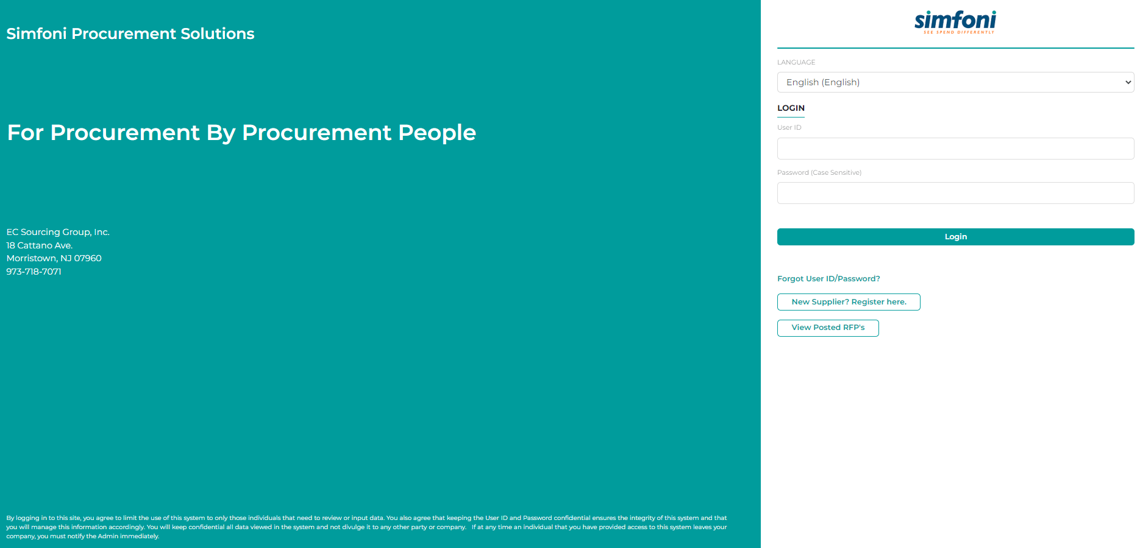
How Sign in
Enter your login ID / PW on the login screen https://infineum.ecsourcing.com

Slide 3
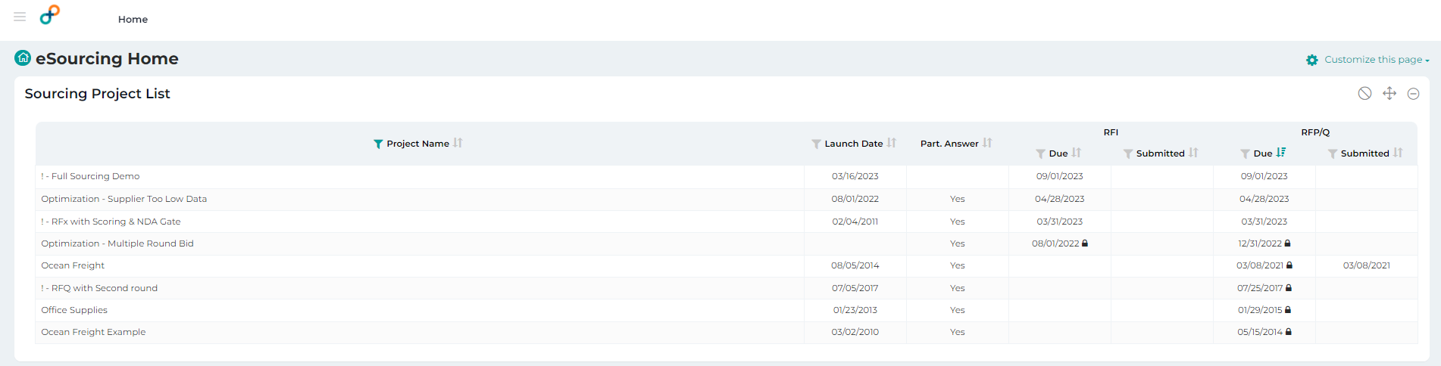
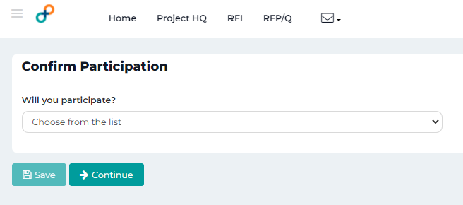
How to select an event / RFP
Select the event / RFP that you have been invited to participate in by clicking the event name from the ‘Sourcing Project List’ table.
You will be asked if you want to participate in that event. Make a selection using the drop down list.

Slide 4
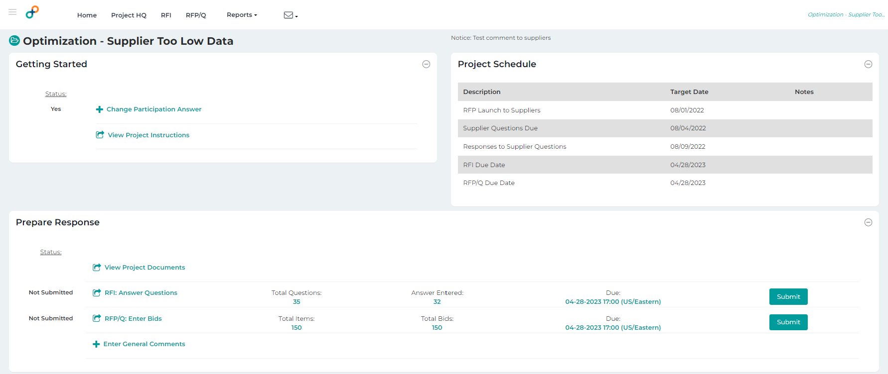
How to view Project Documents
Project Documents are available under the Prepare Response section of Project HQ.
*PLEASE NOTE – not all projects will have project documents.

Slide 5
Where to enter your response
Depending on the project content, you can click the RFI & RFP/Q options from the top menu or the Prepare Response section in the middle of your screen. These two areas are where you will enter your response.

Slide 6

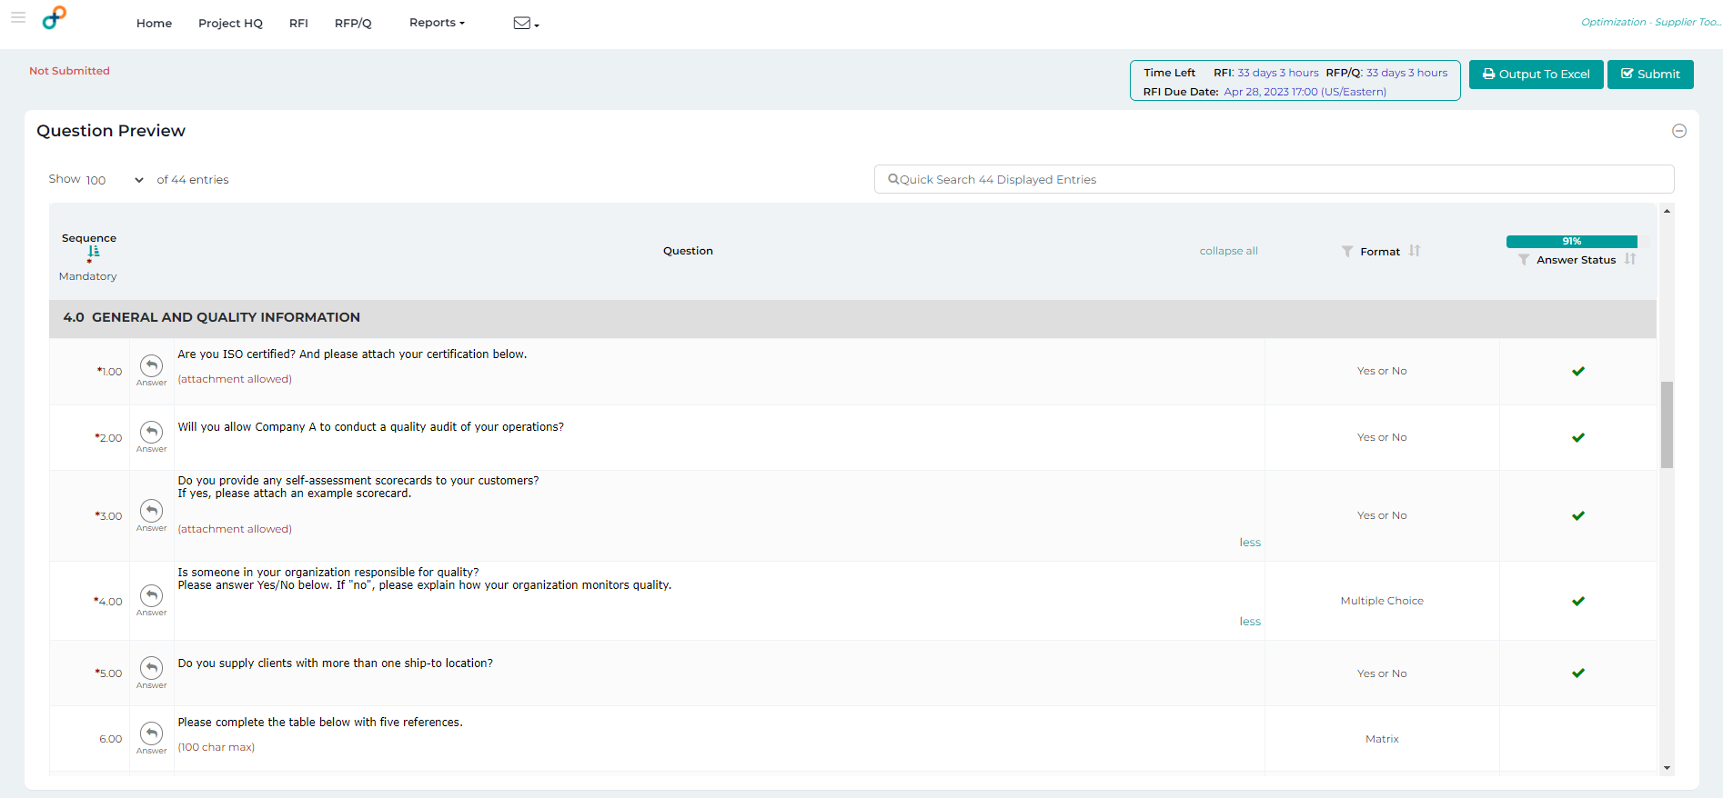
How to enter responses to specific questions
In the RFI area, click the icon to start entering responses to specific questions.

Slide 7
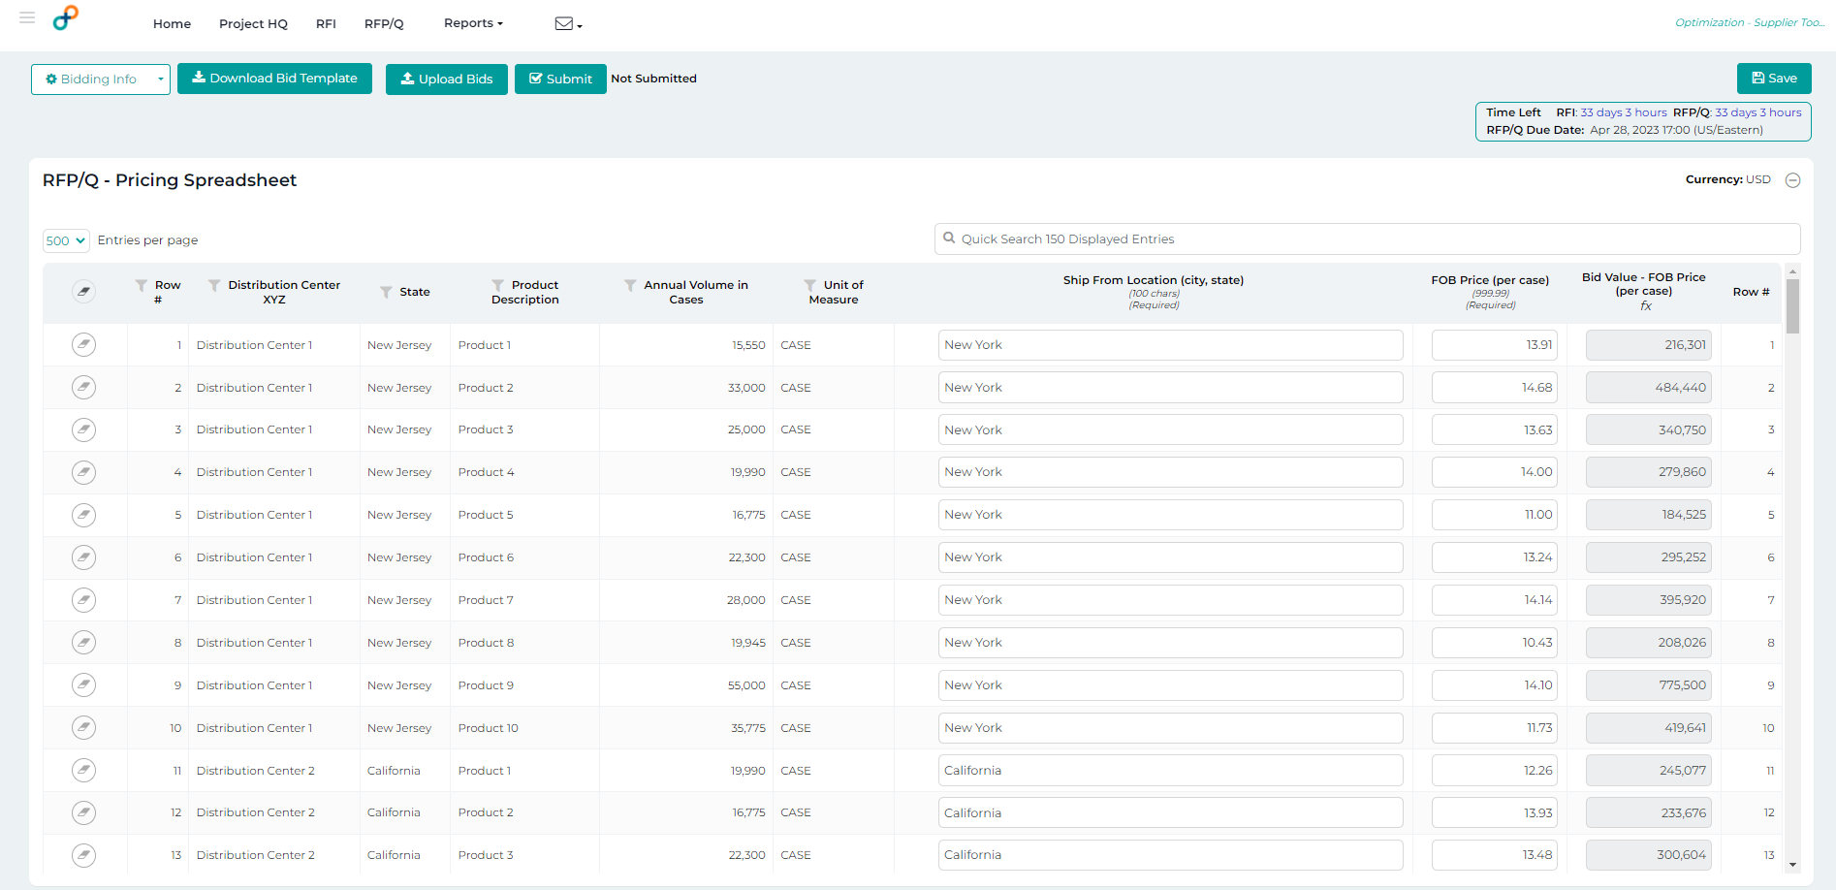
How to enter information on items you want to bid on
In the RFP/Q area, enter the information for ANY line items you wish to bid on. If you do not wish to bid on a specific item, please skip the row entirely.

Slide 8
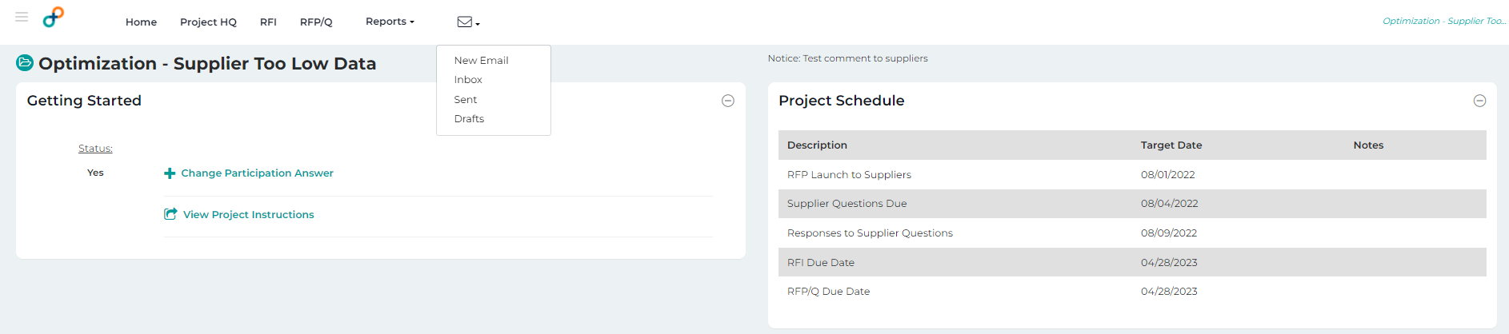
How to send a message to the Project Admins
To send messaging to the Project Admins, expand the Communications area in the top menu and select ‘New Email’.

Slide 9
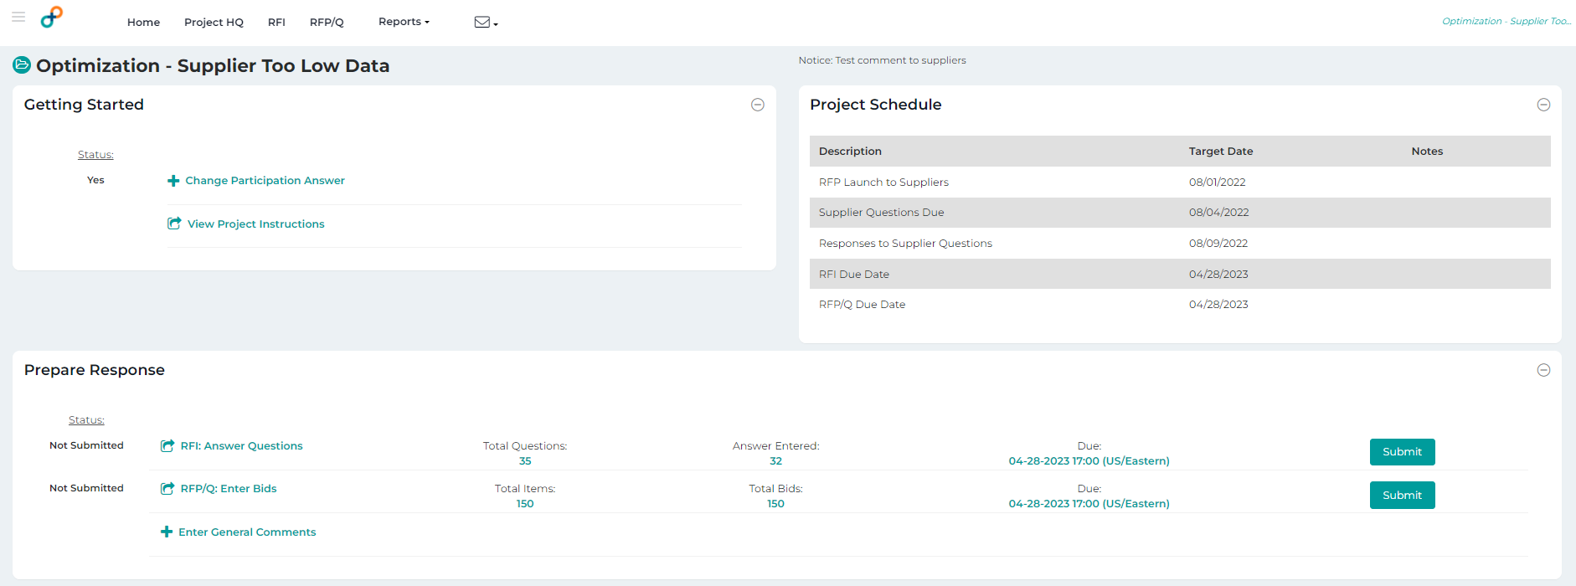
How to submit responses
There are two methods you can use to Submit your response. This displays submitting a bid from the Project Tracking screen.
Project HQ Screen

Slide 10
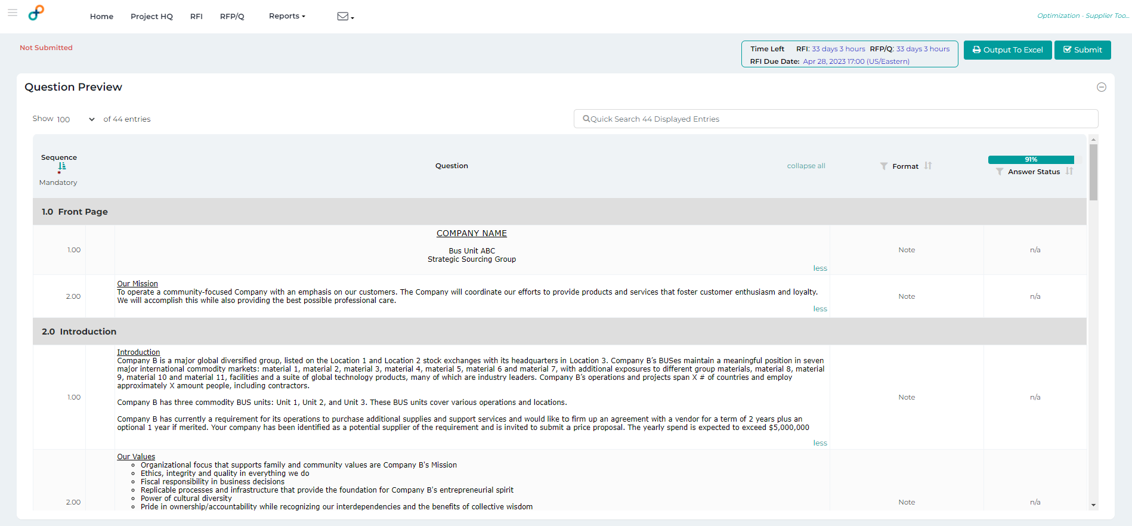
How to submit responses
See display for submitting your response from the RFI screens.

Slide 11
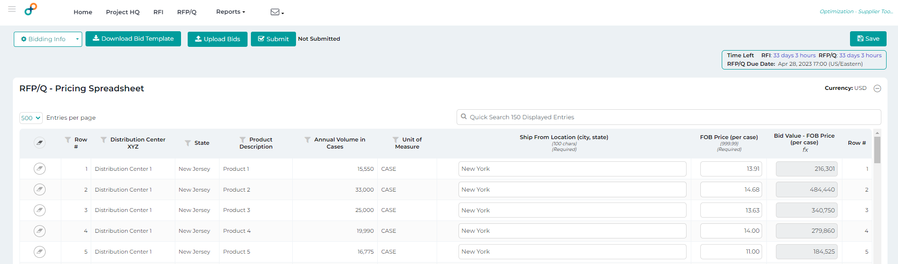
How to submit responses
See display for submitting your response from the RFP/Q screens.

Slide 12
Help and Support Resources
Once invited to participate in the bid, Suppliers can be in touch with Infineum Buyer for any help.

