Slide 1
Infineum Supplier Portal Training: Keelvar eSourcing Platform and Keelvarsity Guide
27/10/2025

Slide 2
Keelvar eSourcing Platform Overview
What is Keelvar Esourcing
Keelvar eSourcing is a cloud-based software platform designed to help organizations manage and optimize their sourcing and procurement processes through intelligent automation. It’s particularly known for its AI-powered sourcing optimization and automation capabilities, which make it easier to run complex sourcing events efficiently.
Notes:
---
This slide references information from the following file: https://infineum-my.sharepoint.com/personal/tariro_kamhoti_infineum_com/_layouts/15/Doc.aspx?sourcedoc=%7B7A11CCA5-60A6-4B75-9E07-BCF7AAC05638%7D&file=Keelvar%20Product%20training%20and%20resources%20manual.docx&action=default&mobileredirect=true
Introduction to Keelvar eSourcing, Key Features of Keelvar, Platform Navigation and Access, User Accounts and Team Member Roles

Slide 3

Introduction to Keelvar eSourcing
Cloud-based Procurement Platform
    Keelvar eSourcing operates on the cloud, allowing easy access and scalable procurement management.
AI-driven Automation
  Artificial intelligence automates complex sourcing events, reducing manual effort and boosting efficiency.
Advanced Bidding and Analysis
  Supports sophisticated bidding formats and scenario analysis to evaluate offers by cost, quality, and sustainability.
Notes:
---
This slide references information from the following file: https://infineum-my.sharepoint.com/personal/tariro_kamhoti_infineum_com/_layouts/15/Doc.aspx?sourcedoc=%7B7A11CCA5-60A6-4B75-9E07-BCF7AAC05638%7D&file=Keelvar%20Product%20training%20and%20resources%20manual.docx&action=default&mobileredirect=true
Keelvar eSourcing is a cloud-based software platform designed to streamline and optimize procurement and sourcing processes. It leverages artificial intelligence to automate complex sourcing events, enabling organizations to manage RFIs, RFQs, RFPs, and auctions efficiently. The platform is particularly known for its intelligent automation capabilities, which reduce manual effort and improve decision-making. By supporting advanced bidding formats and scenario analysis, Keelvar empowers procurement teams to evaluate supplier offers based on multiple criteria such as cost, quality, delivery, and sustainability.

Slide 4

Key Features in Keelvar
Sourcing Optimization Tools
  Supports multi-attribute bidding, lotting, and scenario analysis to optimize sourcing decisions.
Automation Bots
  Automates repetitive tasks like RFQ creation, supplier communication, and bid analysis for efficiency.
Event Management
  Enables creation and management of RFIs, RFQs, RFPs, and auctions via templates and workflows.
Supplier Collaboration and Analytics
  Enhances collaboration with real-time feedback and offers analytics for data-driven procurement decisions.
  Analytics & Reporting:
  Built-in tools for analyzing bids, comparing scenarios, and generating reports.
Notes:
---
This slide references information from the following file: https://infineum-my.sharepoint.com/personal/tariro_kamhoti_infineum_com/_layouts/15/Doc.aspx?sourcedoc=%7B7A11CCA5-60A6-4B75-9E07-BCF7AAC05638%7D&file=Keelvar%20Product%20training%20and%20resources%20manual.docx&action=default&mobileredirect=true
Keelvar offers a suite of powerful features tailored for modern sourcing needs. These include sourcing optimization tools that support multi-attribute bidding, lotting, and scenario analysis. Automation Bots are available to handle repetitive tasks like RFQ creation, supplier communication, and bid analysis, ensuring consistency and speed. The platform also provides robust event management capabilities, allowing users to create and manage RFIs, RFQs, RFPs, and auctions using standardized templates and workflows. Supplier collaboration is enhanced through a user-friendly interface and real-time feedback mechanisms. Additionally, built-in analytics and reporting tools help procurement teams make data-driven decisions by comparing scenarios and generating actionable insights.

Slide 5
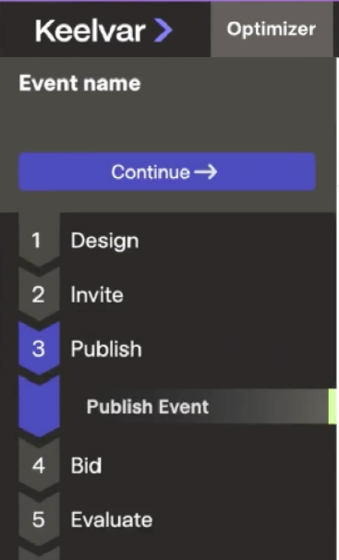
Platform Navigation and Access - User Registration Process
The process of registering is managed by the organisation admin/owner (COE analytics advisor). Infineum colleagues have to raise an onboarding request via email.
After the Infineum organisation admin has confirmed user profile creation on the Keelvar Platform, user should receive an invitation email with a link to register. If you are unable to find our emails, these may have been filtered by your email provider or your organization's email settings. We would recommend trying the following:
  1. Check your spam/ junk folder
  2. Whitelist the Keelvar domain
  3. Escalate the issue to Keelvar org owner
After you register, you will get a second email
allowing you to set a password.
Notes:
---
This slide references information from the following file: https://infineum-my.sharepoint.com/personal/tariro_kamhoti_infineum_com/_layouts/15/Doc.aspx?sourcedoc=%7B7A11CCA5-60A6-4B75-9E07-BCF7AAC05638%7D&file=Keelvar%20Product%20training%20and%20resources%20manual.docx&action=default&mobileredirect=true
Accessing Keelvar begins with registration, which is managed by the organization admin or COE Analytics Advisor. Users receive an invitation email post-onboarding, and should check spam or junk folders if the email is not found. Whitelisting the Keelvar domain or escalating to IT may be necessary. Logging in is typically done via Single Sign-On (SSO) at https://app.keelvar.com, which is recommended for Infineum colleagues. Alternatively, users can log in manually at https://my.keelvar.app using their email and password. Password changes are managed through Account Settings, with requirements including a minimum of 10 characters, uppercase and lowercase letters, a number, and a special character. For login issues, users should contact their IT team or Keelvar Support.

Slide 6
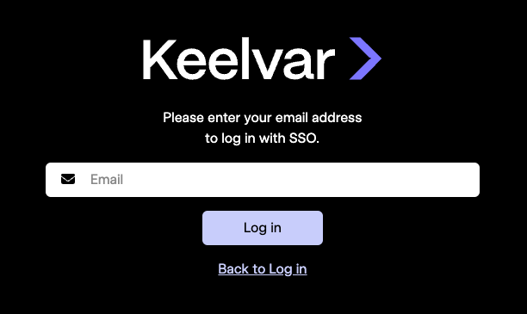
Login Methods –
Users can log in via Single Sign-On (SSO) or manually with email and password for flexibility.
Logging in to your account using SSO (Recommended for all Infineum Colleagues)
Single sign-on (SSO) is an authentication system that enables users to log in to multiple systems using a single identification.When your Keelvar account is set up, you will immediately have SSO enabled for Keelvar and you can use it to log in to the system.
Figure 1. Logging in using SSO
To log in using SSO, complete the following steps:
Go to https://app.keelvar.com.
Click Log in with SSO.
Enter your email address that is used for SSO in the Email field.
Click Log in.
Please note If you are using SSO to log in, you cannot reset your password using the Forgot password method.
If you encounter issues when logging in using SSO, first contact the Org owner. If they cannot resolve the issue after troubleshooting it,they will escalate to Keelvar support via link Support Team.
Figure 1. SSO Login – login with email

Slide 7
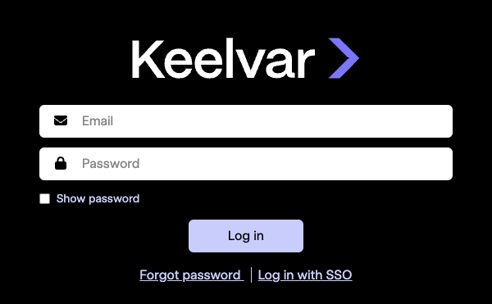
Login Methods
Figure 2. Log in to your Keelvar account
Logging in to your account using a user name and password
Go to https://my.keelvar.app.
Enter your email address in the Email field.
Enter your password in the Password field.
Click Log in.

Slide 8
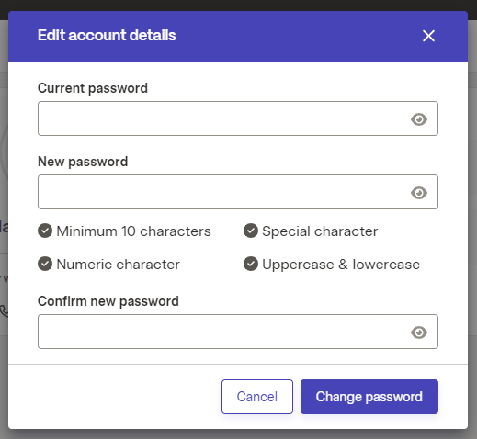
Password Management
Passwords must meet complexity criteria and can be changed via Account Settings securely.
To change your password, complete the following steps:
In the top-right corner of the page, click your account.
Click Account Settings.
In the Your Account section, click Personal Settings.
In the Personal Settings section, click "Edit" in the
password section.
Change your password.
  Enter your current password in the Current Password field.
  Enter your new password in the New Password field.
  Re-enter your new password in the Confirm New Password field.
Click Change Password.
Figure 3. Personal Settings —
Change your password

Slide 9
User accounts and team member roles
In Keelvar, there are organization-level permissions and event-level permissions. Your user account defines your permissions at the organization level and your team member role within an event defines your permissions at the event level.
User accounts – the level of control within the Keelvar app is defined by user account roles
(Restricted) Organization Owner (Infineum Procurement Advisor): The user can create events and access, edit, copy, and delete all events. The organization owner can also create and edit other users.
Standard User: The user can create events and access, copy, or delete events they are added to.
Restricted User: The user can access events they are added to.
Table 1. Sourcing Optimizer user account permissions
Activity | Organization Owner | Standard User | Restricted User
Manage your account | Yes | Yes | Yes
Manage organization | Yes | View-only | View-only
Manage users | Yes | No | No
All events list | Can view and add themselves to any event | No | No
Create events | Yes | Yes | No
Create Bots | Yes | Yes | No

Slide 10
In Event Team Member Roles
Event-level permissions relate to actions within events, such as bid sheet configuration, bid monitoring, and award management. These permissions are defined by your team member role, on a per-event basis.
There are four types of team member roles.
Role Type | Permissions
Admin | Full event access and team management
Editor | View and edit event
Viewer | Read-only access
No Access | No permissions
Notes:
---
This slide references information from the following file: https://infineum-my.sharepoint.com/personal/tariro_kamhoti_infineum_com/_layouts/15/Doc.aspx?sourcedoc=%7B7A11CCA5-60A6-4B75-9E07-BCF7AAC05638%7D&file=Keelvar%20Product%20training%20and%20resources%20manual.docx&action=default&mobileredirect=true
Keelvar defines permissions at both the organization and event levels. Organization-level roles include Owner, Standard User, and Restricted User. Owners have full access and can manage users and events. Standard Users can create and manage their own events, while Restricted Users can only access events they are assigned to. Event-level roles include Admin, Editor, Viewer, and No Access. Admins have full control over event settings and team management. Editors can modify event content, Viewers have read-only access, and users with No Access cannot view the event. These roles ensure appropriate access control and collaboration within sourcing events.

Slide 11
Keelvarsity Training Structure
About Keelvarsity
All Keelvar users in Infineum are expected to complete the basic trainer program in Keelvarsity.
Keelvarsity is Keelvar's self-service online learning management system. Built to enable users to get the most value out of Keelvar. Users will have access to self-paced training content that is both convenient and comprehensive, to encourage you to take the time to become a Keelvar expert. Keelvarsity is frequently updated with new training materials, including monthly webinars and feature spotlight courses, as well as specialized courses like Scenarios Expert and e-Auction Specialist.
If you are an existing user who has not received Keelvarsity access, contact your Organisation Admin/Owner or Keelvar support Support to be invited to join Keelvarsity, where you can self-enroll in courses from the training catalog.
Notes:
---
This slide references information from the following file: https://infineum-my.sharepoint.com/personal/tariro_kamhoti_infineum_com/_layouts/15/Doc.aspx?sourcedoc=%7B7A11CCA5-60A6-4B75-9E07-BCF7AAC05638%7D&file=Keelvar%20Product%20training%20and%20resources%20manual.docx&action=default&mobileredirect=true
Overview of Keelvarsity, Navigating Keelvarsity, Course Catalog and Certifications

Slide 12

Overview of Keelvarsity
Self-Service Learning
Keelvarsity provides a self-service model enabling users to learn at their own pace with convenient access to training materials.
Regular Content Updates
The platform offers updated training content including monthly webinars, feature spotlight courses, and certifications to keep users informed.
Access and Enrollment
Users can gain access by contacting their organization admin or Keelvar Support and self-enroll in courses from the catalog.
Notes:
---
This slide references information from the following file: https://infineum-my.sharepoint.com/personal/tariro_kamhoti_infineum_com/_layouts/15/Doc.aspx?sourcedoc=%7B7A11CCA5-60A6-4B75-9E07-BCF7AAC05638%7D&file=Keelvar%20Product%20training%20and%20resources%20manual.docx&action=default&mobileredirect=true
Keelvarsity is Keelvar’s self-service online learning management system designed to support both customers and staff in maximizing their use of the platform. It offers self-paced training content that is regularly updated with new materials, including monthly webinars, feature spotlight courses, and specialized certifications. The platform encourages users to become Keelvar experts by providing comprehensive and convenient learning paths. Users who have not received access should contact their organization admin or Keelvar Support to be invited to join and self-enroll in courses from the catalog.

Slide 13
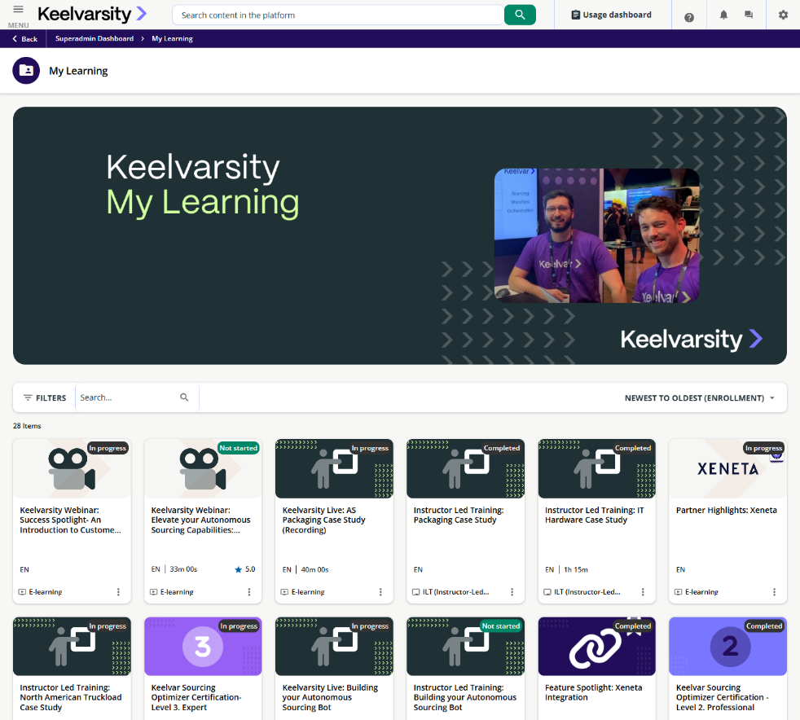
Navigating Keelvarsity
Main Navigation Menu
Access the main menu via the three-line icon at the top-left corner of every page for easy navigation.
Learner Dashboard
The dashboard is the landing page showing enrolled and highlighted courses with scrollable course catalog access.
My Learning Section
Provides a full list of all courses a user has enrolled in or completed for easy tracking.
Tailored Course Catalog
Courses are customized by user roles including partners, academic programs, and pre-sales prospects.
Notes:
---
This slide references information from the following file: https://infineum-my.sharepoint.com/personal/tariro_kamhoti_infineum_com/_layouts/15/Doc.aspx?sourcedoc=%7B7A11CCA5-60A6-4B75-9E07-BCF7AAC05638%7D&file=Keelvar%20Product%20training%20and%20resources%20manual.docx&action=default&mobileredirect=true
Keelvarsity’s interface is designed for ease of use. The main navigation menu is accessed via the top-left corner of any page by clicking the three-line icon. The learner dashboard serves as the default landing page, displaying enrolled and highlighted courses with the ability to scroll through the course catalog. The 'My Learning' section provides a comprehensive list of all courses a user has enrolled in or completed. The course catalog is tailored to user roles, with different offerings for Keelvar Partners, Academic Programs, and Pre-Sales Prospects. It includes certifications, product-specific courses, feature spotlights, webinars, and live instructor-led training sessions.

Slide 14

Course Catalog and Certifications
Structured Course Catalog
Courses are segmented by product and user role to provide tailored learning paths.
Diverse Certifications
Certifications include Essentials, Professional, Expert, Bot Architect, and specialized expert certifications.
Interactive Training Sessions
Webinars and live sessions provide interactive and recorded training led by expert teams.
Certification Completion and Sharing
Each certification path concludes with an exam and users can share their achievements on LinkedIn.
Notes:
---
This slide references information from the following file: https://infineum-my.sharepoint.com/personal/tariro_kamhoti_infineum_com/_layouts/15/Doc.aspx?sourcedoc=%7B7A11CCA5-60A6-4B75-9E07-BCF7AAC05638%7D&file=Keelvar%20Product%20training%20and%20resources%20manual.docx&action=default&mobileredirect=true
Keelvarsity offers a structured catalog of courses segmented by product and user role. The Sourcing Optimizer catalog includes Essentials (90 minutes), Professional (60 minutes), and Expert (90 minutes) certifications. Autonomous Sourcing features Bot Architect and Advanced Bot Architect certifications, focusing on bot creation and advanced configuration. Specialized certifications include Scenarios Expert and E-Auctions Specialist. Additional catalog sections cover Rate Manager, Feature Spotlights, and Partner integrations. Webinars and Keelvarsity Live sessions provide interactive and recorded training led by the Customer Success, Professional Services, and Product teams. Each certification path concludes with an exam, and users are encouraged to share achievements on LinkedIn.

Slide 15
Thank You

Slide 17
Permissions

